Slide 2
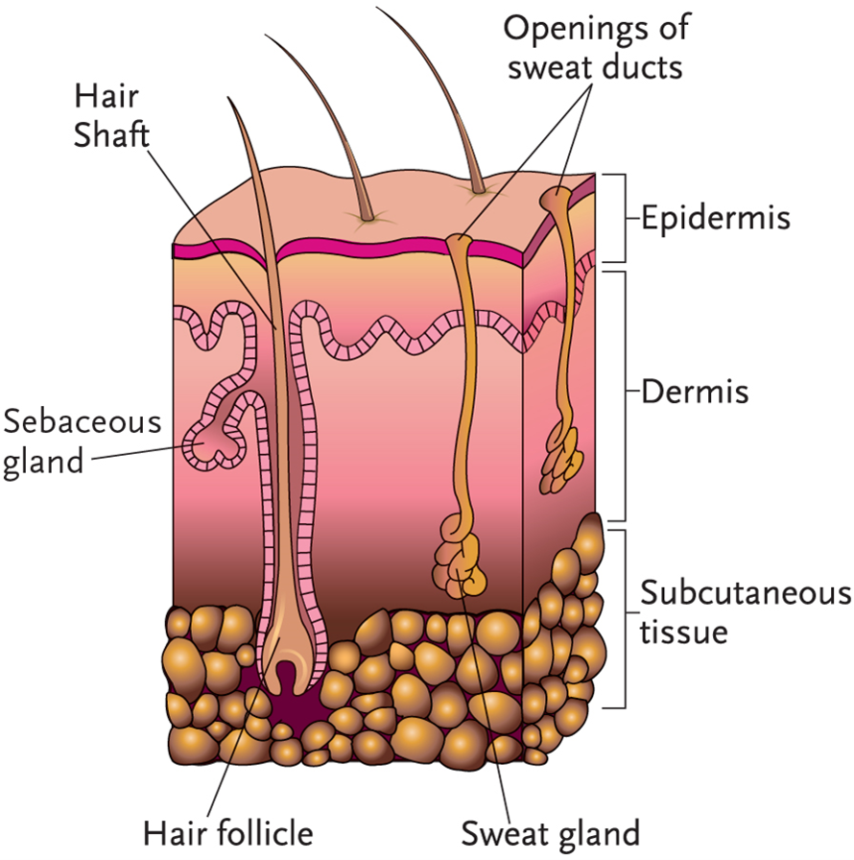
LO1, content 1
Key Material 10-1: The Integumentary System

Slide 3
LO1, content 2
Describe the integumentary system
Remember the following points about the integumentary system:
Largest organ and system
Natural protective covering
Prevents excessive loss of water and injury to internal organs
Skin made of tissue and glands
Skin is a sense organ
Regulates body temperature

Slide 4
LO1, content 3
Describe the integumentary system
Normal changes of aging include the following:
Thinner, drier, more fragile skin
Less elastic skin
Thinning fatty tissue can cause person to feel colder
Thinner, gray hair
Wrinkles and brown spots
Harder, more brittle nails
Dry, itchy skin due to lack of oil from the sebaceous glands

Slide 5
LO2, key terms 1
Discuss common medications used to treat wounds and skin infections
Define the following terms:
wound
a type of injury to the skin.
cellulitis
a bacterial infection affecting the skin and soft tissue.
malaise
a general sense of feeling unwell.

Slide 6
LO2, key terms 2
Discuss common medications used to treat wounds and skin infections
Define the following terms:
methicillin-resistant Staphylococcus aureus
bacteria (Staphylococcus aureus) that have developed resistance to the antibiotic methicillin
sepsis
an infection in the bloodstream.

Slide 7
LO2, content 1
Discuss common medications used to treat wounds and skin infections
Note treatment for wounds (generally beyond scope of practice for MA):
Wound is examined and cleaned as needed with saline or antiseptic solution
Bleeding may need to be stopped
Dressings, bandages, staples, sutures, or strips/glue may need to be applied
In some states MAs may be allowed to apply antibiotic ointment to minor wounds/skin tears, but in other states MAs are prohibited from applying medication to any nonintact skin

Slide 8
LO2, content 2
Discuss common medications used to treat wounds and skin infections
Treatment for cellulitis includes the following:
Mild infection treated with oral antibiotics
Intravenous antibiotics may be needed for more severe cases (systemic symptoms)
Penicillin and cephalosporin antibiotics most commonly used
Side effects include stomach upset, diarrhea, and nausea
Antibiotics can cause anaphylaxis
Table on textbook p. 87 (or handout) details specific drugs

Slide 9
LO2, content 3
Discuss common medications used to treat wounds and skin infections
Remember these points about MRSA:
Can be difficult to treat (sometimes called a super bug
May cause cellulitis, and can also infect wounds
Oral antibiotics may be used for less severe cases
Intravenous antibiotics (e.g., vancomycin) may be used for more severe cases

Slide 10
LO2, content 4
Discuss common medications used to treat wounds and skin infections
Care guidelines for cellulitis include the following:
Report any changes in the resident to your supervisor
Antibiotics can cause anaphylaxis. Get help immediately if you observe signs/symptoms
Always use Standard Precautions
Monitor blood pressure and temperature as ordered. Low blood pressure and fever can be signs of systemic infection
Note any decrease in body temperature (sign that the infection is improving)
Monitor fluid intake and urine output. Kidneys can be damaged by some antibiotics
Watch for confusion and other signs of dehydration if resident experiences diarrhea as an antibiotic side effect

Slide 11
LO3, key terms 1
Discuss common medications used to treat dermatitis and psoriasis
Define the following terms:
pruritus
a medical term for itching.
contact dermatitis
inflammation of the skin caused by contact with an irritant.
atopic dermatitis
inflammation of the skin not related to contact with an irritant; also called eczema.

Slide 12
LO3, key terms 2
Discuss common medications used to treat dermatitis and psoriasis
Define the following terms:
histamines
substances that are part of the body’s immune response.
psoriasis
a chronic, autoimmune skin condition in which the body creates too many skin cells, causing white or red scaly patches.
autoimmune condition
a condition in which the body’s immune system attacks normal tissue in the body.

Slide 13
LO3, content 1
Discuss common medications used to treat dermatitis and psoriasis
Treatment for dermatitis includes the following:
Skin hydration is important
Lotions or creams containing petrolatum or lanolin may be used
Topical or oral corticosteroids reduce inflammation and swelling
OTC topical corticosteroids most helpful where the skin is thin or delicate and for mild cases

Slide 14
LO3, content 2
Discuss common medications used to treat dermatitis and psoriasis
Treatment for dermatitis (cont’d):
Prescription topical or oral corticosteroids may be ordered for more severe cases
Side effects of topical corticosteroids include skin thinning, skin color changes, burning/peeling of the skin, and increased risk of infection
Side effects of oral corticosteroids include weight gain, easy bruising, lower resistance to infection, and mood changes
Antihistamines may also be used to control overreactive, allergic response in the body
Immunosuppressant drugs (topical/oral) are used for severe cases
Side effects include increased sensitivity, soreness, redness, and burning of the skin; headache
Table on textbook p. 87 (or handout) details specific drugs

Slide 15
LO3, content 3
Discuss common medications used to treat dermatitis and psoriasis
Care guidelines for dermatitis include the following:
Apply only the ordered amount of any topical medication
Know that it may take weeks for medications to work
Always use gloves and wash hands thoroughly after administering topical medications
Help residents remember to avoid triggers such as environmental irritants, allergens, and exposure to pollution/weather changes
Report any new triggers observed to the nurse

Slide 16
LO3, content 4
Discuss common medications used to treat dermatitis and psoriasis
Treatment for psoriasis includes the following:
Treatment depends on severity
Milder cases treated with topical corticosteroids and moisturizing lotions/creams
Combination of a strong topical steroid and a vitamin D analog may be ordered
Phototherapy (light treatment) is used to treat moderate to severe cases.
Immunosuppressant drugs may also be ordered
Table on textbook p. 87 (or handout) details specific drugs

Slide 17
LO3, content 5
Discuss common medications used to treat dermatitis and psoriasis
Care guidelines for psoriasis include the following:
Assist with topical therapies as ordered
Observe and report for signs of excessive bleeding or bruising if resident is taking immunosuppressant drugs

Slide 18
LO4, key terms
Discuss common medications used to treat fungal infections, pediculosis, and scabies
Define the following terms:
fungus
a type of living organism that can sometimes cause illness or infection.
candidiasis
overgrowth of the fungus candida on or in the body.
pediculosis
infestation of the hair or body with lice eggs or adult lice.
scabies
a skin condition caused by a mite that burrows under the outer layer of the skin.

Slide 19
LO4, content 1
Discuss common medications used to treat fungal infections, pediculosis, and scabies
The following are common fungal infections:
Athlete’s foot (tinea pedis)
Jock itch (tinea cruris)
Ringworm (tinea corporis)
Candidiasis (including thrush, yeast infection)
Fungal infections of the toenails/fingernails

Slide 20
LO4, content 2
Discuss common medications used to treat fungal infections, pediculosis, and scabies
Treatment for fungal infections includes the following:
Topical antifungal agents (solution/suspension, cream, ointment, gel, powder)
Note that powdered forms are more successful in preventing fungal infections than treating them.
Side effects of topical agents tend to be mild
Oral antifungals may be given along with topical forms. May require longer treatment (especially for toenails)
Side effects of system agents may be more serious and can include liver toxicity, irregular heart rhythm, nausea, vomiting
Many drug interactions are related to oral antifungals
Table on textbook p. 88 (or handout) details specific drugs

Slide 21
LO4, content 3
Discuss common medications used to treat fungal infections, pediculosis, and scabies
Treatment for pediculosis and scabies includes the following:
Drug class is broadly known as miticides
Pediculocides treat lice infestation
Scabicides treat scabies
Most medications for these conditions are topical
When treating lice, the nits (eggs) must be physically removed from the hair in order for treatment to be complete/successful. Not all pediculocides can kill nits.
Scabies is also treated with an oral medication called ivermectin (Stromectol).
Table on textbook p. 88 (or handout) details other specific drugs.

Slide 22
LO5, key terms
Describe burns and sunburn and response to these conditions
Define the following terms:
photosensitivity
increased sensitivity to sunlight; may be caused by some common medications.
petechiae
a condition in which small, flat red or purple dots appear on the skin as a result of leaking capillaries.
purpura
dark red to dark purple patches that appear on the skin due to leakage of red blood cells.

Slide 23
LO5, content 1
Describe burns and sunburn and response to these conditions
Treatment for burns includes the following:
Ointments and other topical medications should only be applied to burns as ordered
Moisture barrier ointments such as Aquaphor may be applied to minor burns to protect tender skin
Topical silver sulfadiazine (Silvadene, SSD) may be used to reduce the risk of infection and promote healing
Antibiotic ointment may be ordered to prevent infection
Topical hydrocortisone can reduce inflammation
Table on textbook p. 88 (or handout) details other specific drugs

Slide 24
LO5, content 2
Describe burns and sunburn and response to these conditions
REMEMBER:
Petechiae and purpura are not classified or treated as skin disorders, but can be associated with a variety of different conditions. Medication aides should report any observations related to petechiae and purpura.

